Slide 1
Stack & Queue Session 05-06
Course : Data Structures
Effective Period : 2023

Slide 2
Learning Outcomes
At the end of this session, students will be able to:
LO 1: Explain the concept of data structures and its usage in Computer Science
LO 2: Illustrate any learned data structure and its usage in application
LO 3: Apply data structures using C

Slide 3
Outline
Stack Concept
Infix, Prefix, Postfix Notation
Stack Applications
Queue Concept
Circular Queue
Priority Queue

Slide 4
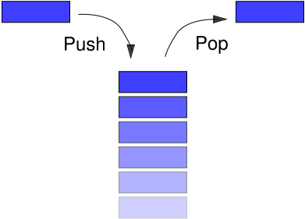
Stack Concept
Stack is a collection data structure which has two fundamental operation: push and pop.
The data are stored in Last In First Out (LIFO) way.
Stack can be implemented using array or linked list *.
Implementing stack using
array is much “easier” than
using linked list.

Slide 5

Array Representation
Stack has two variables:
TOP which is used to store the address of the topmost element of the stack
MAX which is used to store the maximum number of elements that the stack can hold
If TOP = NULL, then indicates that the stack is empty
If TOP = MAX – 1, then the stack is full
TOP=4, insertion and deletion will be done at this position

Slide 6
Linked List Representation
Technique of creating a stack using array is easier, but the drawback is that the array must be declared to have some fixed size.
In a linked stack, every node has two parts:
One that stores data
One that stores the address of the next node
The START pointer of the linked list is used as TOP
All insertions and deletions are done at the node pointed by the TOP
If TOP = NULL, then it indicates that the stack is empty

Slide 7
Stack Operations
push(x) : add an item x to the top of the stack.
pop() : remove an item from the top of the stack.
top() : reveal/return the top item from the stack.
Note: top is also known as peek.

Slide 8
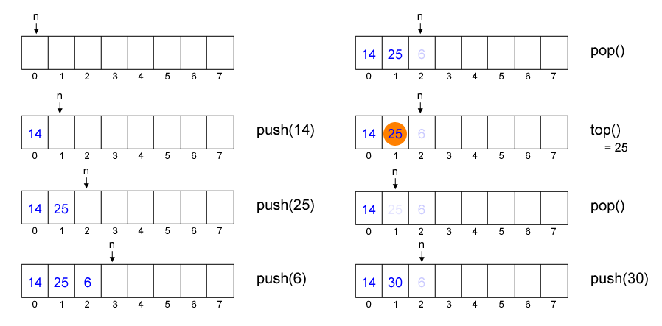
Example of Stack (Array)

Slide 9
Stack: Code – Insertion
struct stack *push (struct stack *top, int val){
struct stack *ptr;
ptr = (struct stack*) malloc (sizeof(struct stack*));
ptr -> data = val;
if (top == NULL){
top = ptr;
top -> next = NULL;
} else {
ptr -> next = top;
top = ptr;
}
return top;
}

Slide 10
Stack: Code – Deletion
struct stack *pop (struct stack *top){
struct stack *ptr;
ptr = top;
if (top == NULL){
printf(“\n STACK UNDERFLOW”);
} else {
top = top -> next;
printf(“\nThe deleted value: %d”, ptr -> data);
free(ptr);
}
return top;
}

Slide 11
Stack: Code – Display
struct stack *display(struct stack *top){
struct stack *ptr;
ptr = top;
if (top == NULL){
printf(“\n STACK IS EMPTY”);
} else {
while(ptr != NULL){
printf(“\n%d”, ptr -> data);
ptr = ptr -> next;
}
}
return top;
}

Slide 12
Stack: Code
Top:
Can you implement these functions?
size()
return the number of data in stack.
is_empty()
return true if there’s no data in stack, otherwise return false.
is_full()
return true if the number of data in stack has reached the maximum limit, otherwise return false.
int peek (struct stack *top){
return top->data;
}

Slide 13
Infix, Postfix, and Prefix Notation
Prefix | Infix | Postfix
* 4 10 | 4 * 10 | 4 10 *
+ 5 * 3 4 | 5 + 3 * 4 | 5 3 4 * +
+ 4 / * 6 – 5 2 3 | 4 + 6 * (5 – 2) / 3 | 4 6 5 2 – * 3 / +
Prefix : operator is written before operands
Infix : operator is written between operands
Postfix : operator is written after operands

Slide 14
Infix, Postfix, and Prefix Notation
Why do we need prefix/postfix notation?
Prefix and postfix notations don’t need brackets to prioritize operator precedence.
Prefix and postfix is much easier for computer to evaluate.

Slide 15
Evaluation: Infix Notation
Evaluate a given infix expression: 4 + 6 * (5 – 2) / 3.
To evaluate infix notation, we should search the highest precedence
operator in the string.
4 + 6 * (5 – 2) / 3 search the highest precedence operator, it is ( )
4 + 6 * 3 / 3 search the highest precedence operator, it is *
4 + 18 / 3 search the highest precedence operator, it is /
4 + 6 search the highest precedence operator, it is +
10
In each search, we should iterate through the string and we do this for
each existing operator, so the overall complexity is O(N²) with N is the
string’s length.

Slide 16
Evaluation: Postfix Notation
Manually
Scan from left to right
7 6 5 x 3 2 ^ – + , scan until reach the first operator
7 6 5 x 3 2 ^ – + , calculate 6 x 5
7 30 3 2 ^ – + , scan again until reach next operator
7 30 3 2 ^ – + , calculate 3²
7 30 9 – + , scan again to search next operator
7 30 9 – + , calculate 30 – 9
7 21 + , scan again
7 21 + , calculate 7 + 24
28 , finish

Slide 17
Evaluation: Postfix Notation
Using Stack
Evaluating a postfix notation can be done in O(N), which is faster than
O(N²)
Algorithm:
Scan the string from left to right, for each character in the string:
If it is an operand, push it into stack.
If it is an operator, pop twice (store in variable A and B respectively) and push(B operator A).
Pay attention here! It is (B operator A), not (A operator B).
The result will be stored in the only element in stack.

Slide 18
Evaluation: Postfix Notation
String Stack
4 6 5 2 – * 3 / +
4 6 5 2 – * 3 / + 4 push(4)
4 6 5 2 – * 3 / + 4 6 push(6)
4 6 5 2 – * 3 / + 4 6 5 push(5)
4 6 5 2 – * 3 / + 4 6 5 2 push(2)
4 6 5 2 – * 3 / + 4 6 3 pop 2, pop 5, push(5 – 2)
4 6 5 2 – * 3 / + 4 18 pop 3, pop 6, push(6 * 3)
4 6 5 2 – * 3 / + 4 18 3 push(3)
4 6 5 2 – * 3 / + 4 6 pop 3, pop 18, push(18 / 3)
4 6 5 2 – * 3 / + 10 pop 6, pop 4, push(10) → the result

Slide 19
Evaluation: Prefix Notation
Manually
Scan from right to left
+ 7 – x 6 5 ^ 3 2
+ 7 – x 6 5 ^ 3 2
+ 7 – x 6 5 9
+ 7 – x 6 5 9
+ 7 – 30 9
+ 7 – 30 9
+ 7 21
+ 7 21
28

Slide 20
Evaluation: Prefix Notation
Using Stack
Evaluating a prefix notation is similar to postfix notation.
Hint: the string is scanned from right to left.
You can do it by yourself.

Slide 21
Conversion: Infix to Postfix Notation
Manually
Algorithm:
Search for the operator which has the highest precedence
Put that operator behind the operands
Repeat until finish

Slide 22
Conversion: Infix to Postfix Notation
Manually
A + B – C x D ^ E / F , power has the highest precedence
A + B – C x D E ^ / F , put ^ behind D and E
A + B – C x D E ^ / F , x and / have same level precedence
A + B – C D E ^ x / F , put x at the end
A + B – C D E ^ x / F , continue with the same algorithm till finish
A + B – C D E ^ x F /
A + B – C D E ^ x F /
A B + – C D E ^ x F /
A B + – C D E ^ x F /
A B + C D E ^ x F / – , this is the Postfix notation

Slide 23
Conversion: Infix to Postfix Notation
Using Stack
Given an infix expression, convert it into postfix notation. It can be
done in O(N).
Algorithm:
Scan the string from left to right, for each character in the string:
If it is an operand, add it to the postfix string.
If it is an open bracket, push it into stack.
If it is a close bracket, pop the stack until you found an open bracket. Add each popped element to the postfix string.
If it is an operator, pop while the stack’s top element has higher or equal precedence than the scanned character. Add each popped element to the postfix string. Push the scanned character into stack.
After you have scanned all character, pop all elements in stack and add them to
postfix string.

Slide 24
Conversion: Infix to Postfix Notation
String | Stack | Postfix String | Operation
4 + 6 * (5 – 2) / 3 | - | - | -
4 + 6 * (5 – 2) / 3 |  | 4 | add(4)
4 + 6 * (5 – 2) / 3 | + | 4 | push(+)
4 + 6 * (5 – 2) / 3 | + | 4 6 | add(6)
4 + 6 * (5 – 2) / 3 | + * | 4 6 | push(*)
4 + 6 * (5 – 2) / 3 | + * ( | 4 6 | push(()
4 + 6 * (5 – 2) / 3 | + * ( | 4 6 5 | add(5)
4 + 6 * (5 – 2) / 3 | + * ( - | 4 6 5 | push(-)
4 + 6 * (5 – 2) / 3 | + * ( - | 4 6 5 2 | add(2)
4 + 6 * (5 – 2) / 3 | + * | 4 6 5 2 - | pop(-)
4 + 6 * (5 – 2) / 3 | + / | 4 6 5 2 - * | pop(*), push(/)
4 + 6 * (5 – 2) / 3 | + / | 4 6 5 2 - * 3 | add(3)
4 + 6 * (5 – 2) / 3 |  | 4 6 5 2 - * 3 / + | pop(/), pop(+)

Slide 25
Conversion: Infix to Prefix Notation
Manually
Algorithm:
Search for the operator which has the highest precedence
Put that operator before the operands
Repeat until finish

Slide 26
Conversion: Infix to Prefix Notation
Manually
A + B – C x D ^ E / F
A + B – C x ^ D E / F
A + B – C x ^ D E / F
A + B – x C ^ D E / F
A + B – x C ^ D E / F
A + B – / x C ^ D E F
A + B – / x C ^ D E F
+ A B – / x C ^ D E F
+ A B – / x C ^ D E F
– + A B / x C ^ D E F , this is the Prefix notation

Slide 27
Conversion: Infix to Prefix Notation
Using Stack
It is quiet similar with the conversion from Infix to Postfix.
Hint: the string is scanned from right to left.

Slide 28
Conversion: Infix to Prefix Notation
String | Stack | Prefix String | Operation
4 + 6 * (5 – 2) / 3 | - | - | -
4 + 6 * (5 – 2) / 3 |  | 3 | add(3)
4 + 6 * (5 – 2) / 3 | / | 3 | push(/)
4 + 6 * (5 – 2) / 3 | / ) | 3 | push())
4 + 6 * (5 – 2) / 3 | / ) | 2 3 | add(2)
4 + 6 * (5 – 2) / 3 | / ) - | 2 3 | push(-)
4 + 6 * (5 – 2) / 3 | / ) - | 5 2 3 | add(5)
4 + 6 * (5 – 2) / 3 | / | - 5 2 3 | pop(-)
4 + 6 * (5 – 2) / 3 | / * | - 5 2 3 | push(*)
4 + 6 * (5 – 2) / 3 | / * | 6 - 5 2 3 | add(6)
4 + 6 * (5 – 2) / 3 | + | / * 6 - 5 2 3 | pop(*),pop(/),push(+)
4 + 6 * (5 – 2) / 3 | + | 4 / * 6 - 5 2 3 | add(4)
4 + 6 * (5 – 2) / 3 |  | + 4 / * 6 - 5 2 3 | pop(+)

Slide 29
Depth First Search
Depth First Search (DFS) is an algorithm for traversing or searching
in a tree or graph. We start at the root of the tree (or some arbitrary
node in graph) and explore as far as possible along each branch before
backtracking.
DFS has many applications, such as:
Finding articulation point and bridge in a graph
Finding connected component
Topological sorting
etc.
DFS can be implemented by a recursive function or an iterative
procedure using stack, their results may have a little differences on
visiting order but both are correct.

Slide 30
Depth First Search
Algorithm:
Prepare an empty stack
Push source/root into stack
Mark source/root
While stack is not empty
Pop an item from stack into P
For each node X adjacent with P
If X is not marked
Mark X
Push X into stack

Slide 31
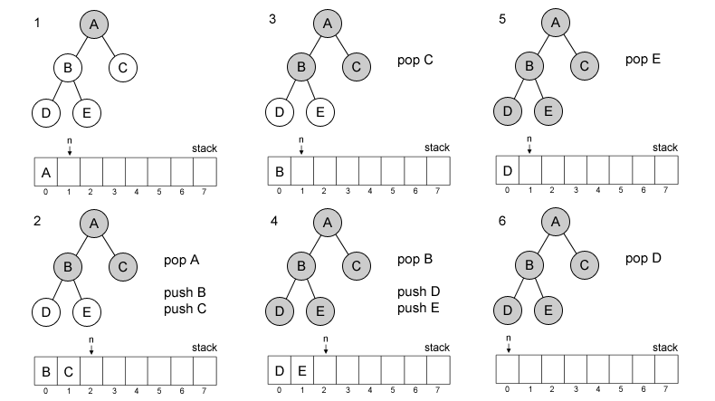
Depth First Search
Visit order: A, C, B, E, D

Slide 32
Other Stack Applications
Stacks are widely used to:
Reverse the order of data
Convert infix expression into postfix
Convert postfix expression into infix
Backtracking problem
System stack is used in every recursive function
Converting a decimal number into its binary equivalent

Slide 33
Queue Concept
Queue is a collection data structure which has two fundamental operation: push and pop (similar to stack).
The data are stored in First In First Out (FIFO) way, this is the main difference between stack and queue.

Slide 34
Array Representation
Queue has two variables:
Front and rear that point to the position where deletions and insertions can be done respectively
For examples:
Here, front = 0 and rear = 5.
12 | 9 | 7 | 18 | 14 | 36
0 1 2 3 4 5 6 7 8 9

Slide 35
Linked List Representation
Similar with stack, technique of creating a queue using array is easy, but its drawback is that the array must be declared to have some fixed size.
In a linked queue, every element has two parts
One that stores the data
Another that stores the address of the next element
The START pointer of the linked list is used as the FRONT
All insertions will be done at the REAR, and all the deletions are done at the FRONT end.
If FRONT = REAR = NULL, then it indicates that the queue is empty

Slide 36
Queue Operations
push(x) : add an item x to the back of the queue.
pop() : remove an item from the front of the queue.
front() : reveal/return the most front item from the
queue.
front is also known as peek.

Slide 37
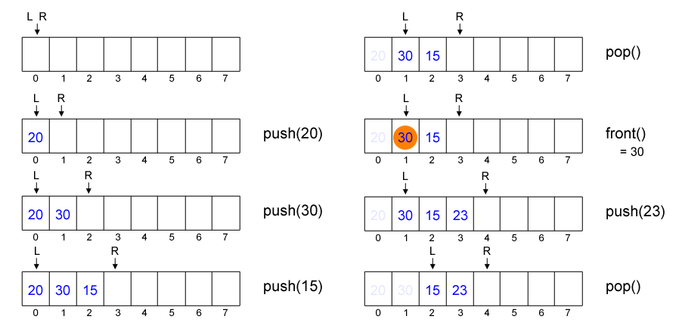
Example of Queue Operations

Slide 38
Queue Code
Insertion:
void insert(){
int num;
printf(“\nEnter number to be inserted : “);
scanf(“%d”,&num);
if (rear == MAX-1) printf (“\n OVERFLOW”);
if (front == -1 && rear == -1)
front = rear = 0;
else
rear++;
queue[rear] = num;
}

Slide 39
Queue Code
Deletion:
void delete_element(){
int val;
if (front == -1 || front>rear){
printf(“\n UNDERFLOW”);
return -1;
}
else {
front++;
val = queue[front]
return val;
}
}

Slide 40
Queue Code
Display:
void display(){
int i;
printf(“\n”);
for (i=front; i<=rear; i++)
printf(“\t %d”, queue[i]);
}
Top:
int peek (){
return queue[front];
}

Slide 41
Queue
Using the previous implementation, what will happen if we push MAXN times and pop MAXN times, and we try to push another data into the queue?
Yes, we can not do that. The R index will overflow (exceeding MAXN), which means the new data will be stored outside the array range.
It seems very inefficient, how to deal with this?

Slide 42
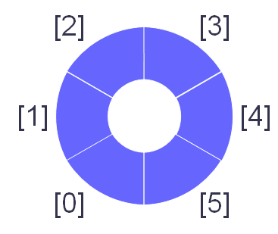
Circular Queue
We can wrap-around index L and R.
If R reach MAXN then set R as zero, do the same to L.
It is also known as circular queue.

Slide 43
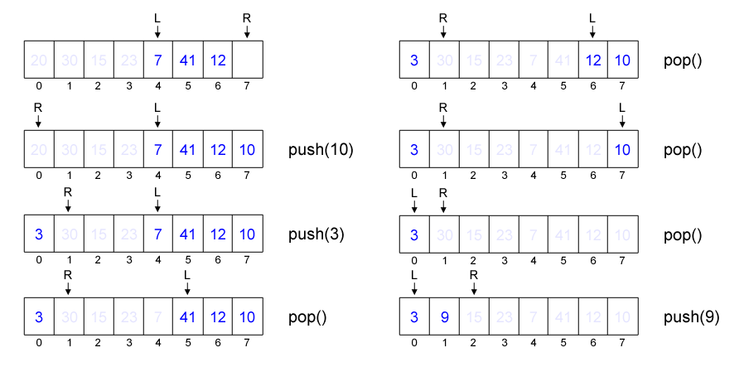
Circular Queue

Slide 44
Circular Queue Code
Insertion:
void insert(){
int num;
printf(“\nEnter number to be inserted : “);
scanf(“%d”,&num);
if (front == 0 && rear == MAX-1)
printf (“\n OVERFLOW”);
else if (front == -1 && rear == -1){
front = rear = 0;
queue[rear] = num;
}else if (rear == MAX-1 && front != 0){
rear = 0;
queue[rear] = num;
}else{
rear++;
queue[rear] = num;
}
}

Slide 45
Circular Queue Code
Deletion:
void delete_element(){
int val;
if (front == -1){
printf (“\n UNDERFLOW”);
return -1;
}
val = queue[front];
if (front == rear)
front = rear = -1;
else{
if (front == MAX-1)
front = 0;
else
front++;
}
}

Slide 46
Circular Queue Code
Display:
void display(){
int i;
printf(“\n”);
if (front != -1 && rear != -1){
if (front<rear){
for (i=front; i<= rear; i++)
print(“\t %d”, queue[i]);
} else {
for (i=front; i<MAX; i++)
printf(“\t %d”, queue[i]);
for (i=0; i<rear; i++)
printf(“\t %d”, queue[i]);
}
}
}

Slide 47
Circular Queue
Can you implement these functions?
size()
return the number of data in queue.
is_empty()
return true if there’s no data in queue, otherwise return false.
is_full()
return true if the number of data in queue has reached the maximum limit, otherwise return false.

Slide 48
Deques
A deque (pronounced as ‘deck’ or ‘dequeue’) is a list in which elements can be inserted or deleted at either end. It is also known as a head-tail linked list, because elements can be added to or removed from the front (head) or back (tail).
 |  |  | 29 | 37 | 45 | 54 | 63
0 1 2 LEFT = 3 4 5 6 RIGHT = 7 8 9
42 | 56 |  |  |  |  |  | 63 | 27 | 18
RIGHT = 0 1 2 LEFT = 3 4 5 6 LEFT = 7 8 9

Slide 49
Deques
Two variants of a double-ended queue, include:
Input restricted deque
In this dequeue insertions can be done only at one of the dequeue while deletions can be done from both the ends.
Output restricted deque
In this dequeue deletions can be done only at one of the dequeue while insertions can be done on both the ends.

Slide 50
Priority Queue
A priority queue is an abstract data type in which the each element is assigned a priority.
The general rule of processing elements of a priority queue can be given as:
An element with higher priority is processes before an element with lower priority
Two elements with same priority are processed on a first come first served (FCFS) basis

Slide 51
Priority Queue
Priority queue after insertion of a new node:
Lower priority number means higher priority.
Deletion:
Deletion is a very simple process in this case.
The first node of the list will be deleted and the data of that node will be processed first
A
1
B
2
C
3
D
5
E
6
X
A
1
B
2
C
3
F
4
D
5
E
6
X

Slide 52
Breadth First Search
Breadth First Search (BFS) like DFS is also an algorithm for traversing or searching in a tree or graph.
We start at the root of the tree (or some arbitrary node in graph) and explore all neighboring nodes level per level until we find the goal.
BFS has many applications, such as:
Finding connected component in a graph.
Finding shortest path in an unweighted graph.
Ford-Fulkerson method for computing maximum flow.
etc.

Slide 53
Breadth First Search
The difference between DFS and BFS iterative implementation is only the data structure being used.
DFS uses stack while BFS uses queue.

Slide 54
Breadth First Search
Algorithm:
Prepare an empty queue
Push source/root into queue
Mark source/root
While queue is not empty
Pop an item from queue into P
For each node X adjacent with P
If X is not marked
Mark X
Push X into queue

Slide 55
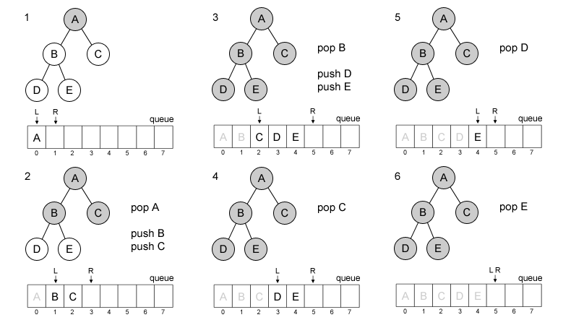
Breadth First Search
Visit order: A, B, C, D, E

Slide 56
References
S. Sridhar. 2015. Design and Analysis of Algorithms. Oxford University Press. New Delhi. ISBN: 9780198093695. Chapter 5
Reema Thareja. 2014. Data structures using C. Oxford University Press. New Delhi. ISBN:9780198099307. Chapter 7 & 8
Thomas H. Cormen, Charles E. Leiserson, Ronald L. Rivest, & Clifford Stein. (2009). Introduction to Algorithms. 03. The MIT Press. London. ISBN: 9780262033848. Chapter 10
Stack, https://visualgo.net/en/list?slide=4
Queue, https://visualgo.net/en/list?slide=5

